Slide 1

Image Classifier
Presented by Ama Ananaba & Anthony Iwu

Slide 2
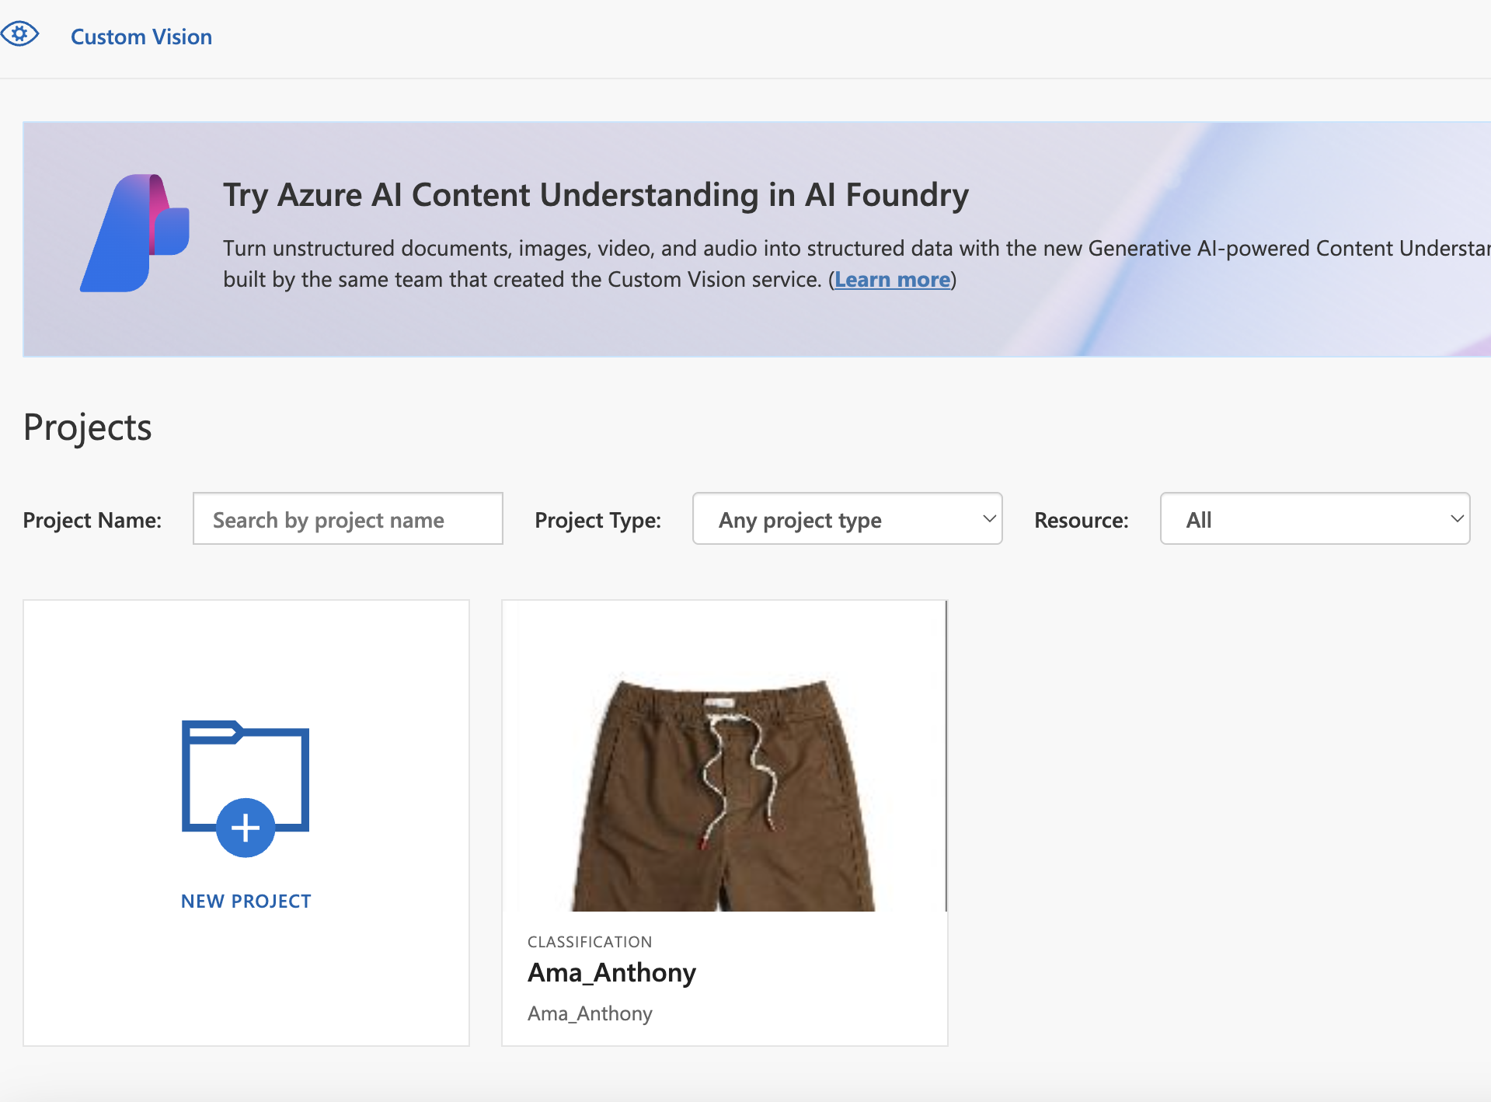
Procedure for Image Classifier creation
Create an Azure student account
Create a new project and give it a title [Ama_Anthony]
Set the type of model as “Classification” and set up other specifications accordingly

Slide 3
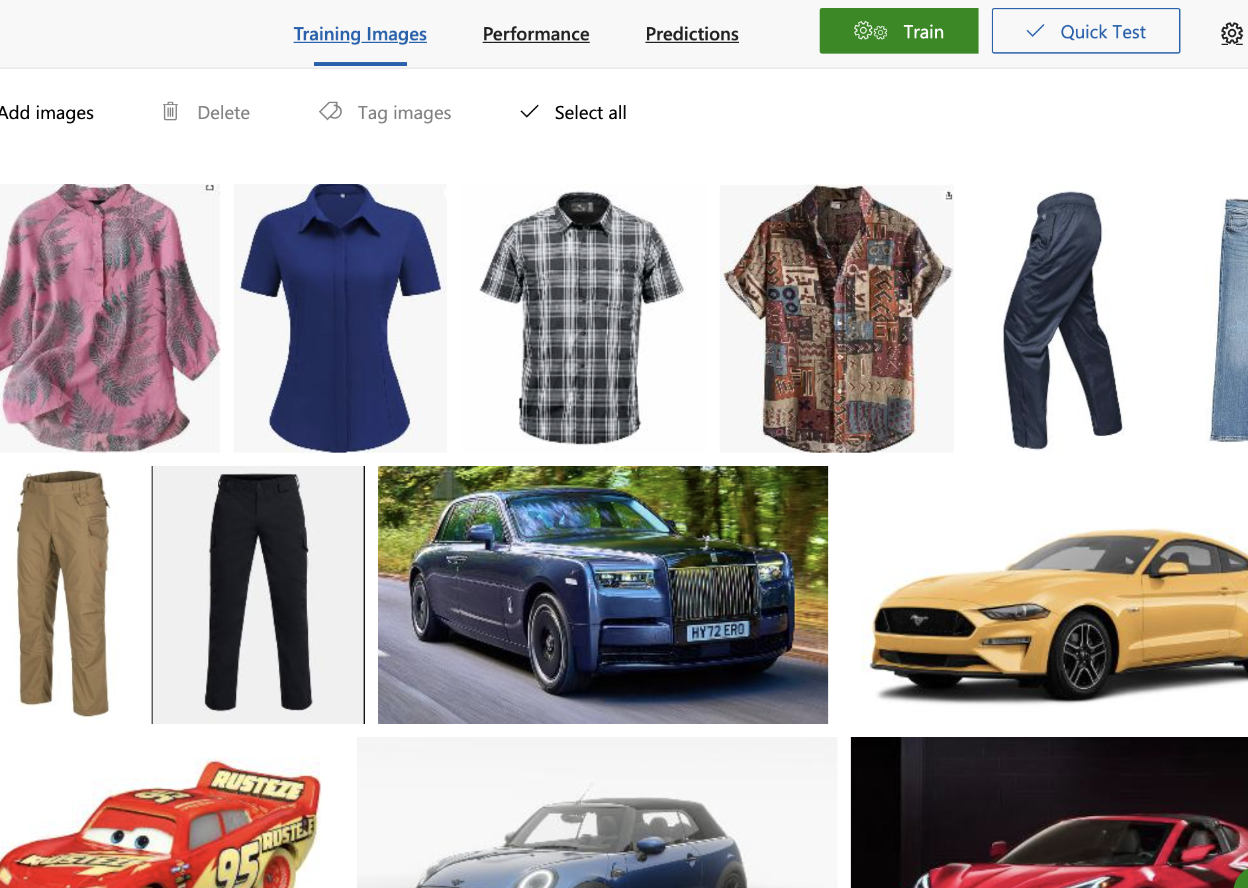
Training Phase
Create 3 to 6 categories of classification for the model
Train the model using 5 tagged images for each category (Supervised training)
Repeat the training for 5 iterations and record the performances

Slide 4
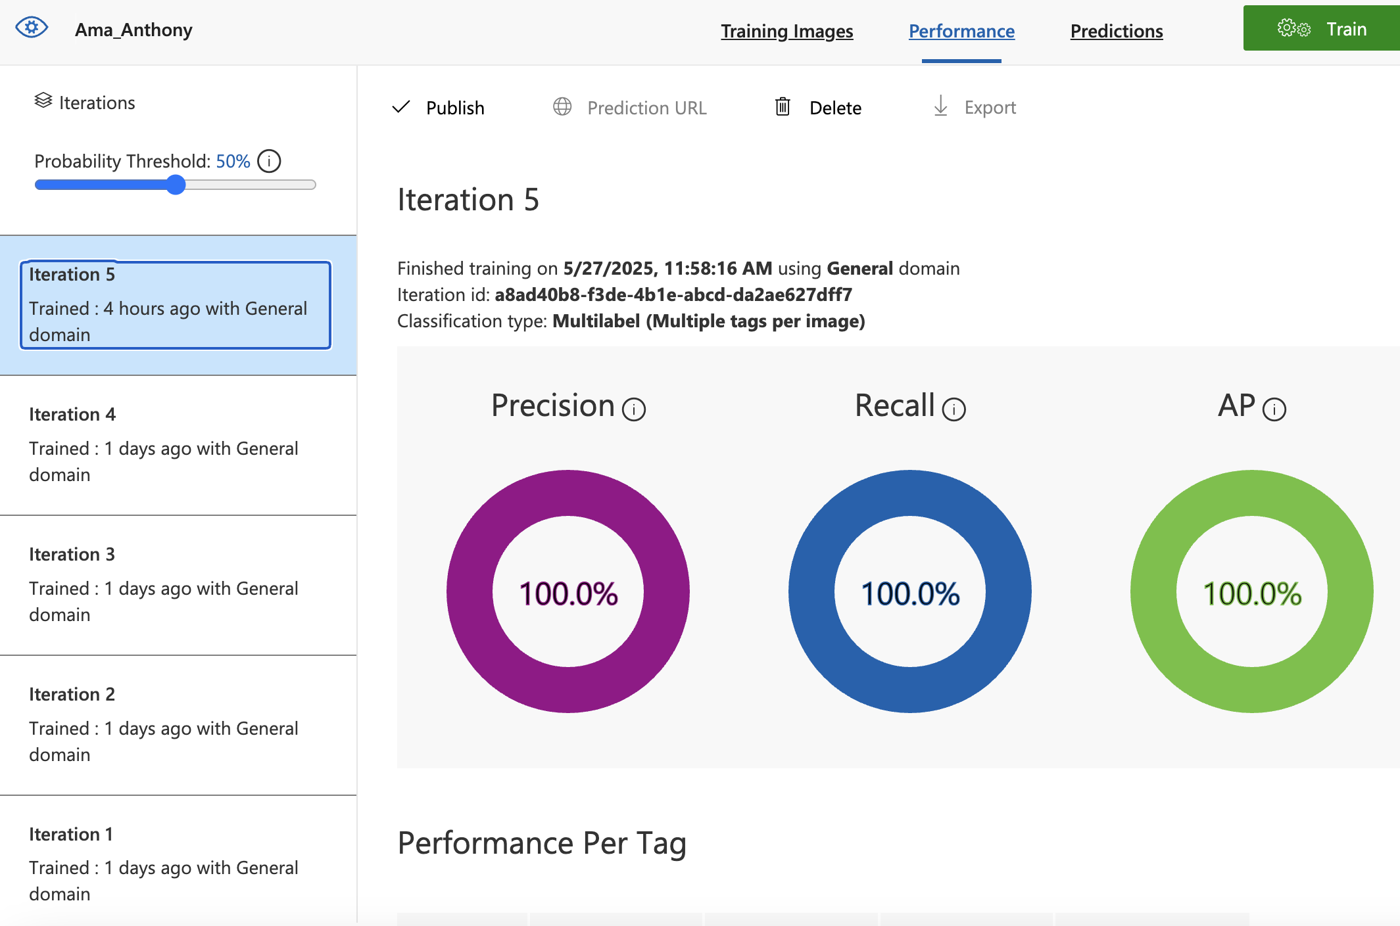
Model Performance
After running all 5 iterations, ensure the model performance is consistent
Ensure that KPIs (Key Performance Indicators) are above 80%

Slide 5
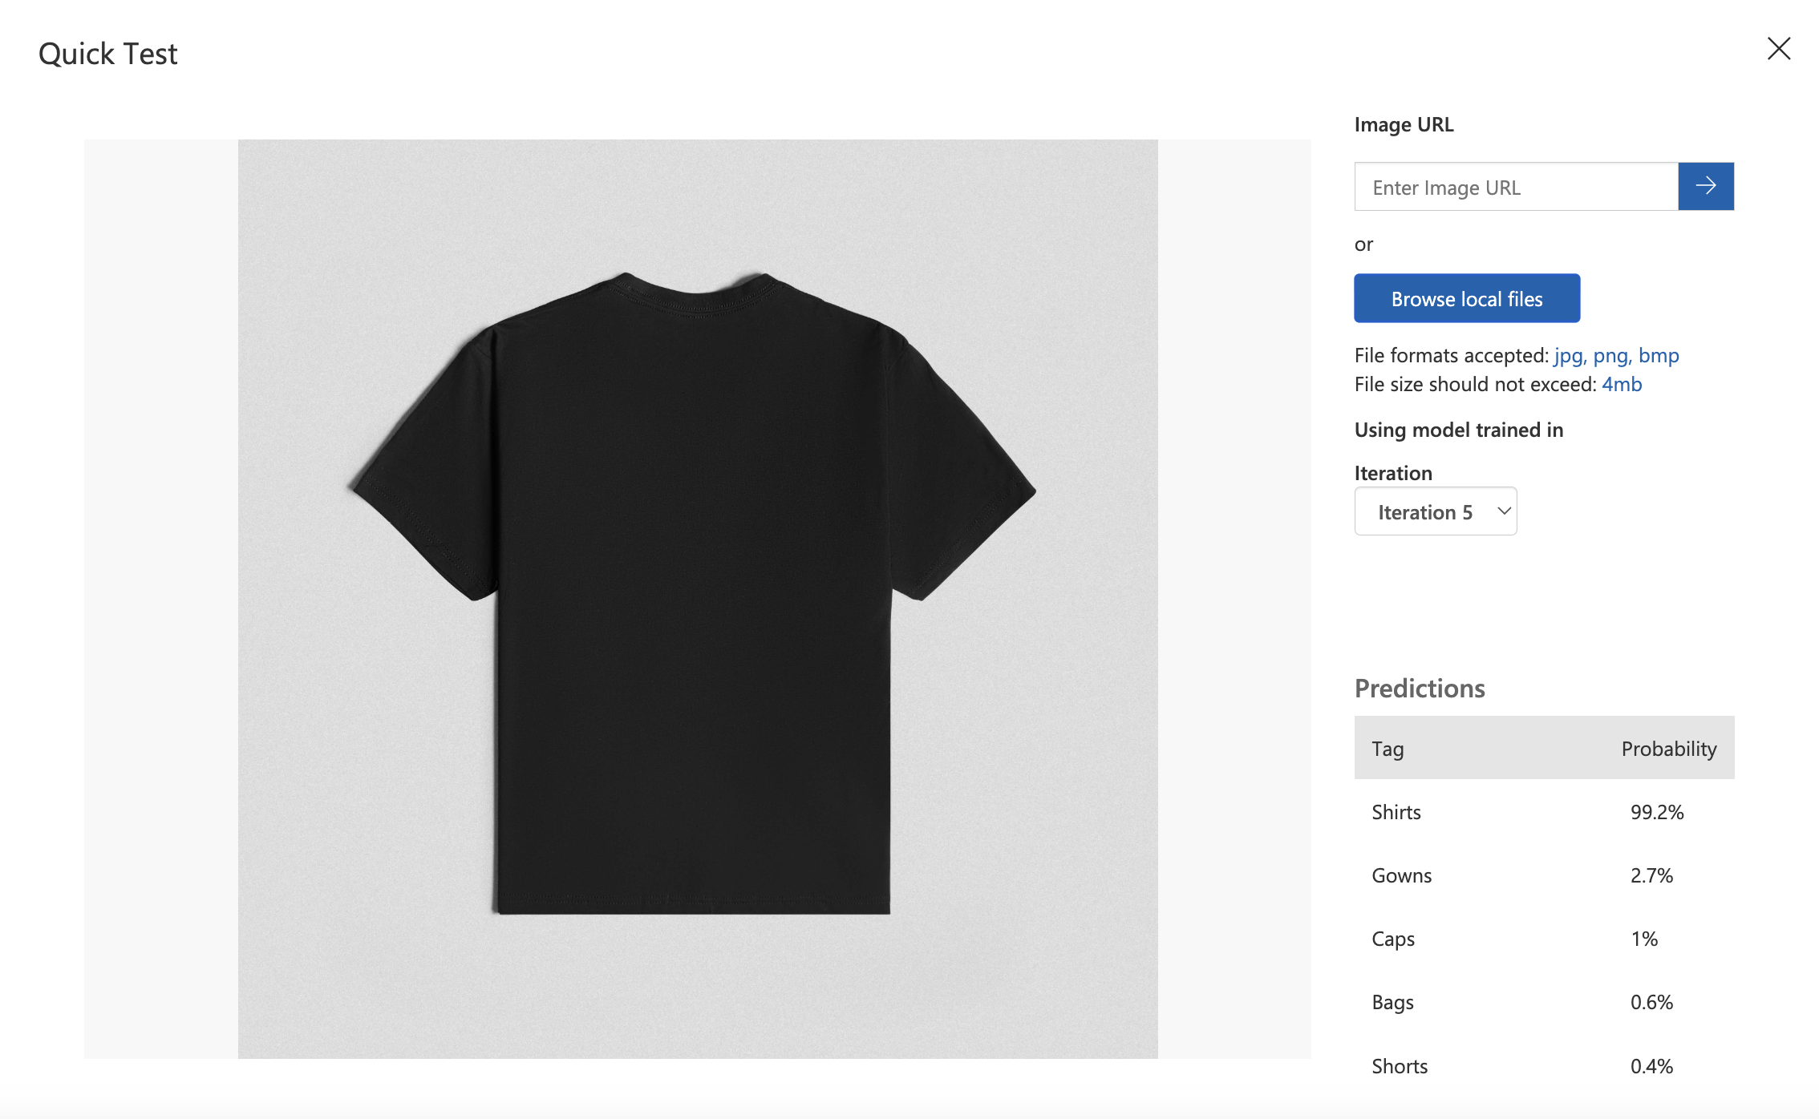
Testing Phase
Ensure to use an image that is untagged and uncategorized by the model
Upload the image into the test field and run the model
The model, if calibrated properly, should classify the new image with minimal error

Slide 6
Applications of Image Classification Models in Enterprises
Image classification models can help in real-time decision making for autonomous driving by identifying and classifying road signs and obstacles.
They can help diagnose health conditions by using medical imaging to classify tumors, fractures and infections.
They can also help to identify and classify unusual activity or unauthorized access in video surveillance.
These models can help identify, classify and interpret images of labels for automatic tracking.
They can help manufacturing companies to detect defects, anomalies, or inconsistencies in products during quality control.

